Slide 1
NODEJS
GET - POST – PUT - DELETE
Notes:
le parsing json de la request et de la réponse (du coup ausi j'ai vu, c'est specifique aux POST/PUT)
req.body
accessoirement la gestion des erreur dans le catch

Slide 2

Look at this request
GET https://192.14.25.16/videocall/incall/?peer_id=77
Q1 – What is the verb (=method) of this request (GET/POST/PUT/DELETE) ?
Q2 – What is the path of this request ?
Q3 – What is the server IP address of this request ?
Q4 – What is the port number of this request ?
Q5 – What are the query parameters of this request ?

Slide 3
Do you remember the 2 ways to set parameters in a GET?
1 - USING QUERY PARAMETERS
2 - USING ROUTE PARAMETERS
localhost: 3000/book?id=2
localhost: 3000/book/2
app.get("/book", (req, res) => {
let id = req.query.id
res.send(“id is:" + id);
});
app.get("/book/:id", (req, res) => {
let id = req.params.id
res.send(“id is:" + id);
});

Slide 4

OBJECTIVES FOR TODAY
Understand the structure of a POST/PUT/DELETE request
Understand when to use the request methods:
GET
POST
PUT
DELETE

Slide 5
GET REQUEST PROBLEMS
URL has a LIMITED size
Parameters are VISIBLE on URL
https://192.14.25.16/videocall/incall/?password=iHateDurian
We cannot send image,
music, binary data

Slide 6


LET’S SEND A POST REQUEST
ENDPOINT
NO MORE
PARAMETERS
POST https://192.14.25.16/login
BODY
{
“id”: ‘ronan’,
“password”: ‘iHateDurian’
}
BUT
DATA
IN
THE
BODY
(=Payload)
JSON format

Slide 7


CONFIGURATION OF EXPRESS
TO READ JSON ON BODY
app.use(express.urlencoded());
app.use(express.json());
Now EXPRESS
is able to READ the BODY of the request
as a JSON value

Slide 8


SEND + CATCH A POST
SEND POST ON CLIENT
CATCH A POST ON SERVER
Let postUrl = serverIP + '/login';
Let postValue = {
id: 'Fred',
password: 'bobo'
};
axios.post(postUrl, postValue)
.then( r => console.log(r.data));
app.post('/login', (req, res) => {
let body = req.body;
let name=body.id;
return res.send('hello' + name);
})

Slide 9

PRACTICE
ACTIVITY 1
10 MIN
LOGIN -PROJECT
Change the GET to a POST
Notes:
http://www.omdbapi.com/

Slide 10
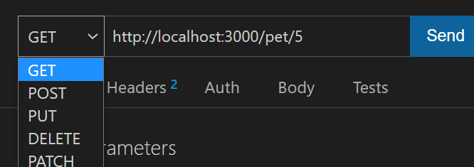
PRACTICE
ACTIVITY 2
15 MIN
Install express (with « npm install »)
Start the node server
Try to send these requests from Thunder client:
GET http://localhost/student/2
POST http://localhost/student
PUT http://localhost/student/2
DELETE http://localhost/student/2
Change the method of the request !
Which function is executed on the server for each request ?
Notes:
http://www.omdbapi.com/

Slide 11

Other HTTP methods:
PUT and DELETE !
GET
POST
HOW TO
CHOOSE ?
DELETE
PUT

Slide 12
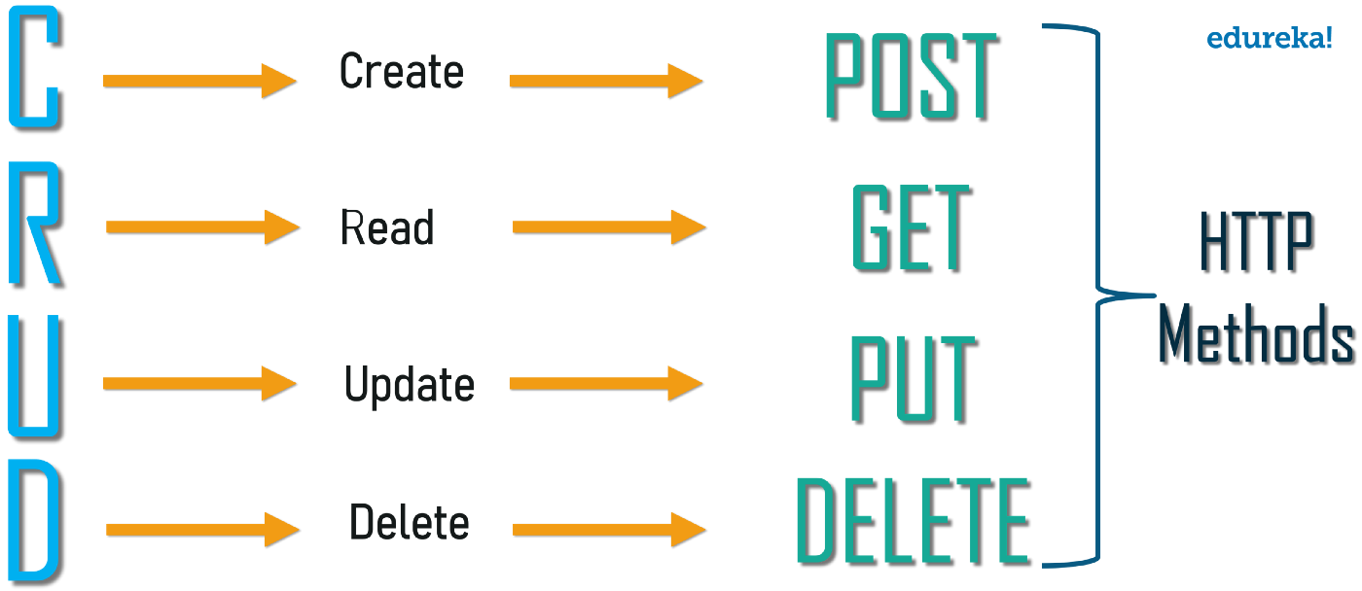
Good practice: One method for each CRUD operations

Slide 13
HTTP Methods usage comparison
HTTP METHOD | CRUD operation | Parameters in | Path Example
GET | READ | Query | /pet/{id} | Find pet by id
POST | CREATE | Request Body | /pet | Create a new pet
PUT | UPDATE | Request Body | /pet/{id} | Update an existing pet by id
DELETE | DELETE | Query | /pet/{id} | Delete a pet by id
Same path but different action !

Slide 14
Which method to use ?
GET
PUT
DELETE
POST
REQUEST | HTTP Method
See the list of restaurants available
Filter the food to see Khmer food only
Buy something on food panda
Create a new account
Change profile photo
Cancel an order
Set the traffic light to RED

Slide 15
LIST
FILTER
GET VIEW
SEE DATA
GET
NO CHANGE ON SERVER
POST
DELETE
PUT
ADD
UPDATE
SET CHANGE
REMOVE
CHANGE DATA
CHANGE ON SERVER

Slide 16
POST VS PUT
ENDPOINT
ENDPOINT
POST https://192.14.25.16/user
PUT https://192.14.25.16/user/5
BODY
BODY
{
“name”: ‘ronan’,
“email”: ‘ronan@gmail.com’
}
{
“name”: ‘ronan’,
“email”: ‘ronanogor@gmail.com’
}
If you do many times the same request, you update the same data so you change nothing => PUT is “idempotent”
If you do many times the same request, you create many users

Slide 17
PRACTICE
PRACTICE
20 MIN
Complete the functions from activity 2 to perform all CRUD operations on data
Then call these functions from front-end with axios !
axios.get(url);
axios.post(url, body);
axios.put(url, body);
axios.delete(url);
Notes:
http://www.omdbapi.com/

